Slide 1

PROJECT BASED LEARNING
Yaw Control of ROV using Raspberry Pi through SIMULINK

Slide 2


Group Members
Maha Arshad
Taha Mahmood
2017187
2017472
0304-2079462
0304-2210055
mahaarshad18@gmail.com
taha.mahmood.73@gmail.com

Slide 3
1. Literature Review
The following papers were consulted when finding the literature review.
1. Rov Autonomization – Yaw Identification And Automarine Module Architecture
In this paper, an autonomous underwater vehicle is developed, by automating the yaw control of the underwater vehicle. To do so, a control system was designed by defined the series of equation for the yaw of the vehicle.
2. Autonomous Control for a Differential Thrust ROV
This paper focuses on the fabrication of the autonomous underwater vehicle which uses the surge and yaw motion control to increase the maneuverability of the vehicle in the terrain.
3. The Basic Study of Underwater Robot Control for Over Actuated Systems
In this paper, an over actuated Remote Operated Vehicle where 4 horizontal thrusters and 4 vertical thrusters are used to control the motion of the 6 DOF Furthermore, for operator’s convenience an autopilot feature is added by having a yaw control.

Slide 4
3. Methodology
Mechanical Design
Mathematical Modelling
Electronic Architecture
Simulation
Settings
Control System
Calibration
Result Optimization

Slide 5
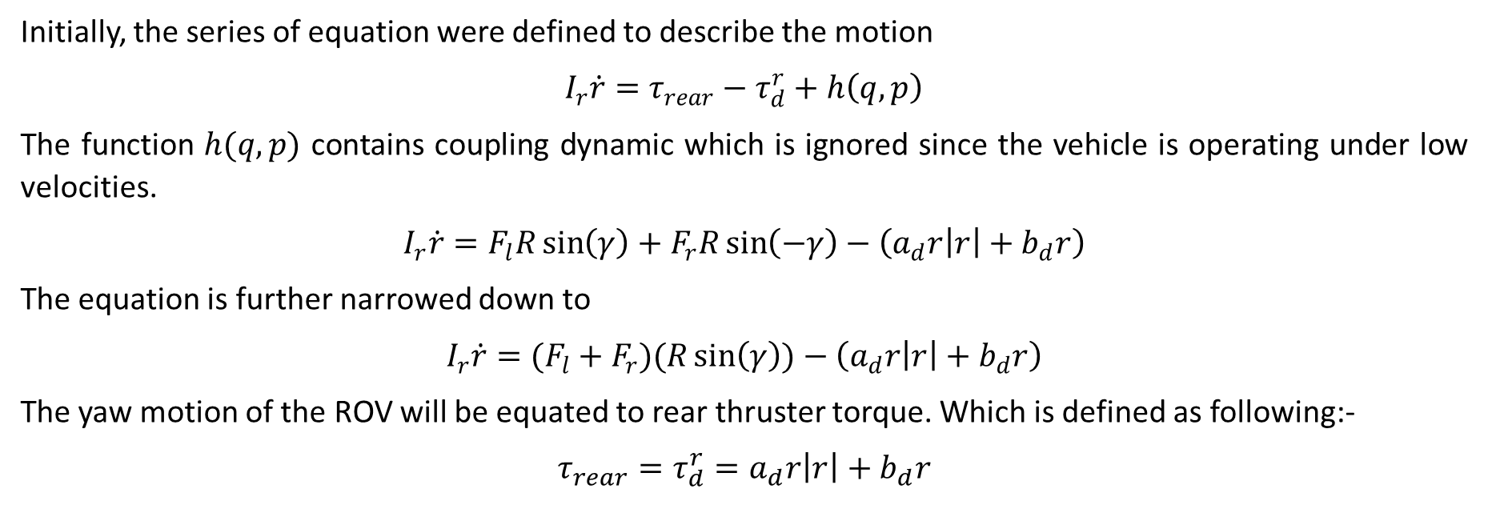
4. Yaw Equation
Initially, the series of equation were defined to describe the motion
$$I_{r}\dot{r}=τ_{rear}−τ_{d}^{r}+h\left(q,p\right)$$
The function $h(q,p)$ contains coupling dynamic which is ignored since the vehicle is operating under low velocities.
$$I_{r}\dot{r}=F_{l}R\sin\left(γ\right)+F_{r}R\sin\left(−γ\right)−\left(a_{d}r\left|r\right|+b_{d}r\right)$$
The equation is further narrowed down to
$$I_{r}\dot{r}=(F_{l}+F_{r})(R\sin\left(γ\right))−\left(a_{d}r\left|r\right|+b_{d}r\right)$$
The yaw motion of the ROV will be equated to rear thruster torque. Which is defined as following:-
$$τ_{rear}=τ_{d}^{r}=a_{d}r\left|r\right|+b_{d}r$$

Slide 6
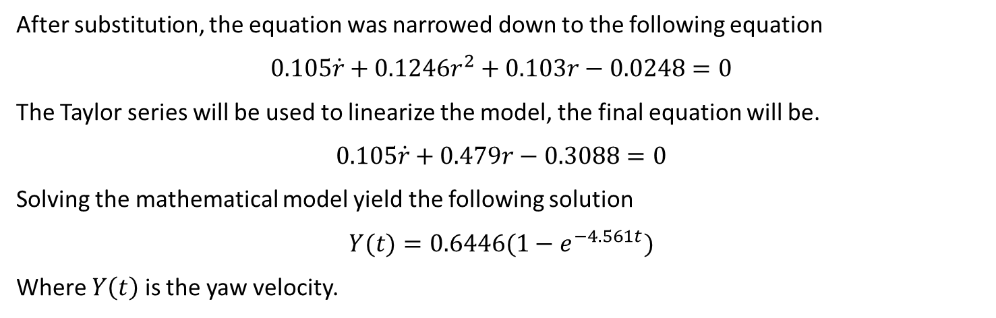
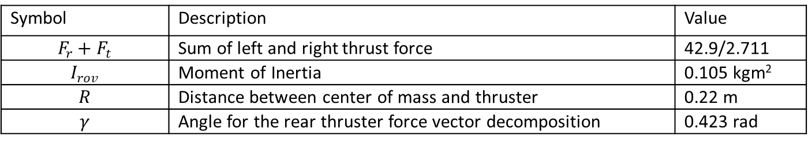
5. Haptic Feedback Device Modelling
Symbol | Description | Value
$$F_{r}+F_{t}$$ | Sum of left and right thrust force | 42.9/2.711
$$I_{rov}$$ | Moment of Inertia | 0.105 kgm²
$$R$$ | Distance between center of mass and thruster | 0.22 m
$$γ$$ | Angle for the rear thruster force vector decomposition | 0.423 rad
After substitution, the equation was narrowed down to the following equation
$$0.105\dot{r}+0.1246r^{2}+0.103r−0.0248=0$$
The Taylor series will be used to linearize the model, the final equation will be.
$$0.105\dot{r}+0.479r−0.3088=0$$
Solving the mathematical model yield the following solution
$$Y(t)=0.6446(1−e^{−4.561t})$$
Where $Y\left(t\right)$ is the yaw velocity.

Slide 7
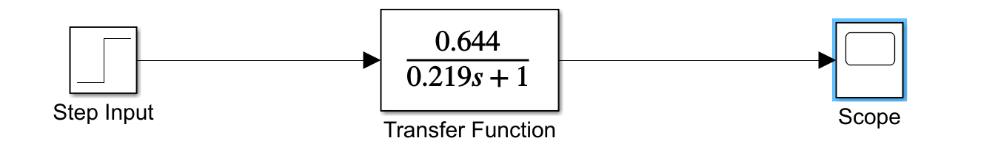
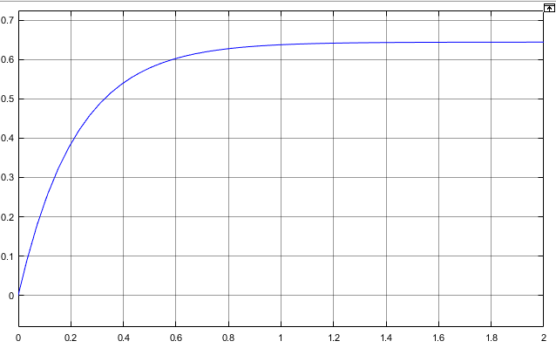
6. Open Loop Response
Time Response of system
$$4τ=4\left(0.219\right)=0.876 sec$$

Slide 8
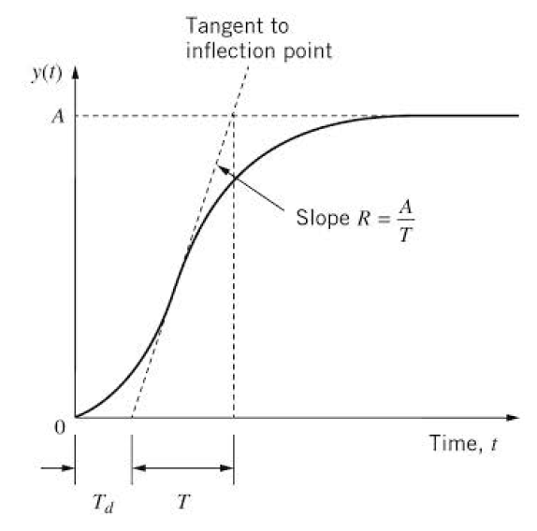
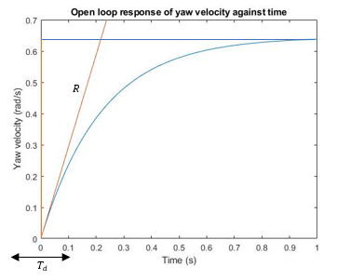
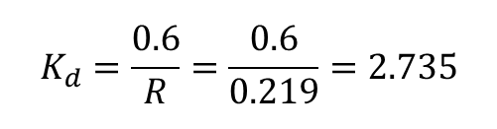
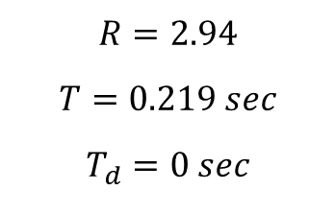
7. Ziegler-Nichols Tuning Method
$$R=2.94$$
$$T=0.219 sec$$
$$T_{d}=0 sec$$
$$K_{d}=\frac{0.6}{R}=\frac{0.6}{0.219}=2.735$$
These parameters can not be utilized in the PID Controller

Slide 9
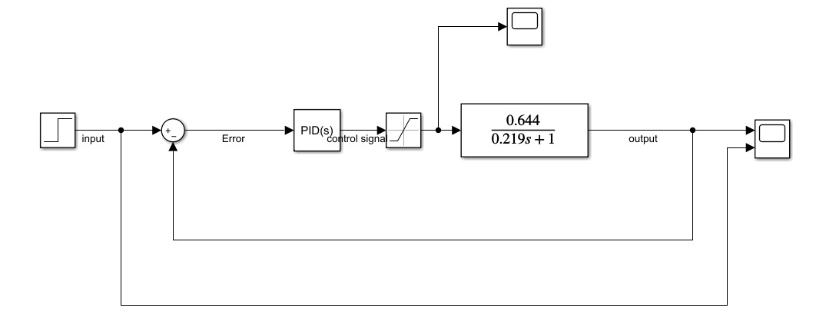
8. Closed Loop Response
This is the SIMULINK model of the closed loop response. Furthermore, a PID controller and a Saturation block is implemented to fine tune the response.

Slide 10
9. Root Locus Method

